Slide 1



Participation Intensity Influences Motivations for Participating in iNaturalist
Samantha K. Lowe, Brittany M. Mason, Nia A. Morales, and
Corey T. Callaghan

Slide 2
Motivations for participating in citizen science
Understanding what motivates participants can improve recruitment and maintenance of participants
People participate in projects that accommodate their motivations
Contributing to science and learning are two strong motivators for biodiversity-oriented citizen science projects
West et al., 2021; Larson et al., 2020; Asingizwe et al., 2020; Maund et al., 2020

Slide 3



Knowledge Gap
How do motivations change throughout the duration of participation?
INITIAL
PRESENT
TIME
Motivations tend to be collectivistic
Science and conservation is an even more important motivator
Motivations tend to be egoistic
Larson et al., 2020; Asingizwe et al., 2020; Bible and Clarke-de Reza, 2023

Slide 4

Addressing this knowledge gap with iNaturalist
Broad in scope based on number of users (3.5M) and diverse interests of users
Results may be applicable to other citizen science projects

Slide 5
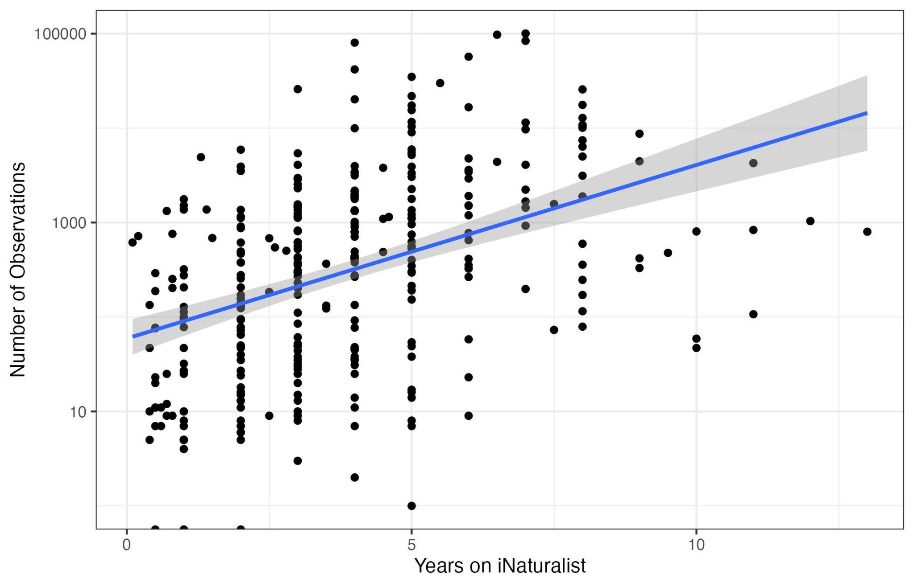
Using participation intensity
Used iNaturalist observation count as measure of participation intensity
Positively correlates with time since joining the platform

Slide 6

Methods
Quota Sampling of U.S. iNat users
Stratified users into 5 groups by observation count
100 users sampled per group + 2 resamples
Utilized iNat DMs
Convenience sampling
Spanish version of survey available
11 weeks
Survey Design & Pilot
15 motivations on a 5-point likert scale
User metrics (observation count, etc.)
Demographics
n=208
n=221
Notes:
Quota sampling represents today’s results.

Slide 7
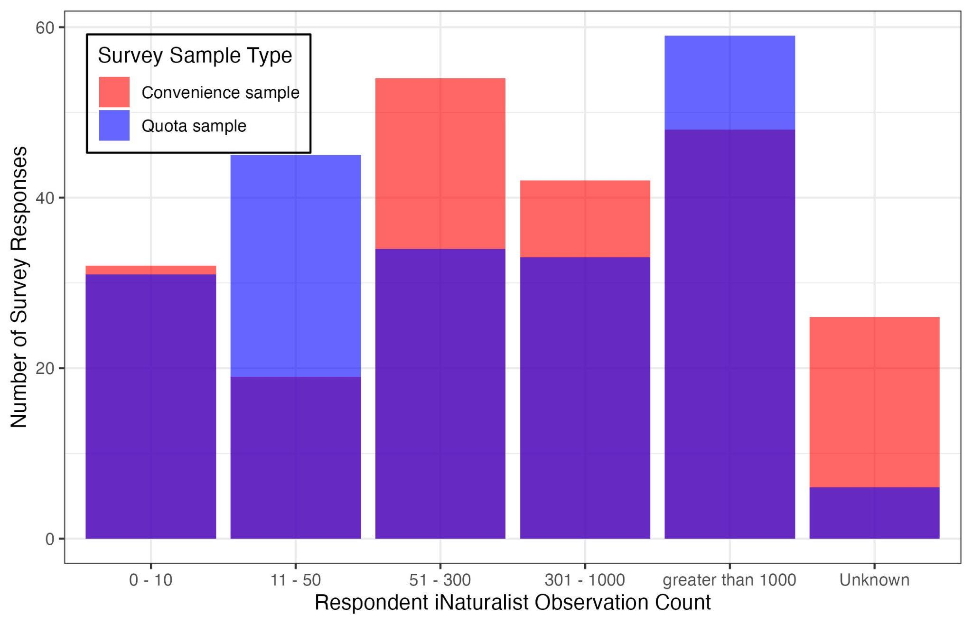
Survey response results
N=429

Slide 8
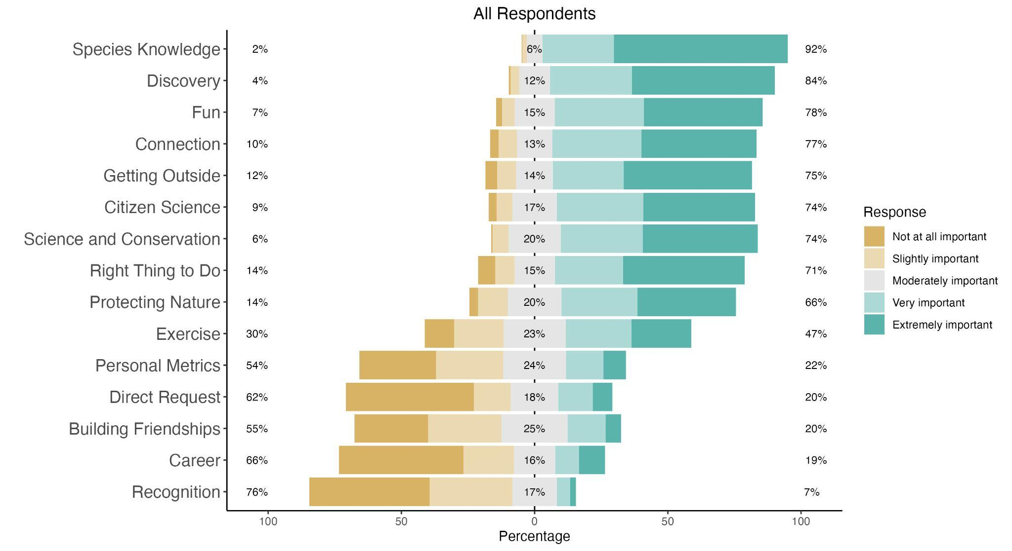

Slide 9
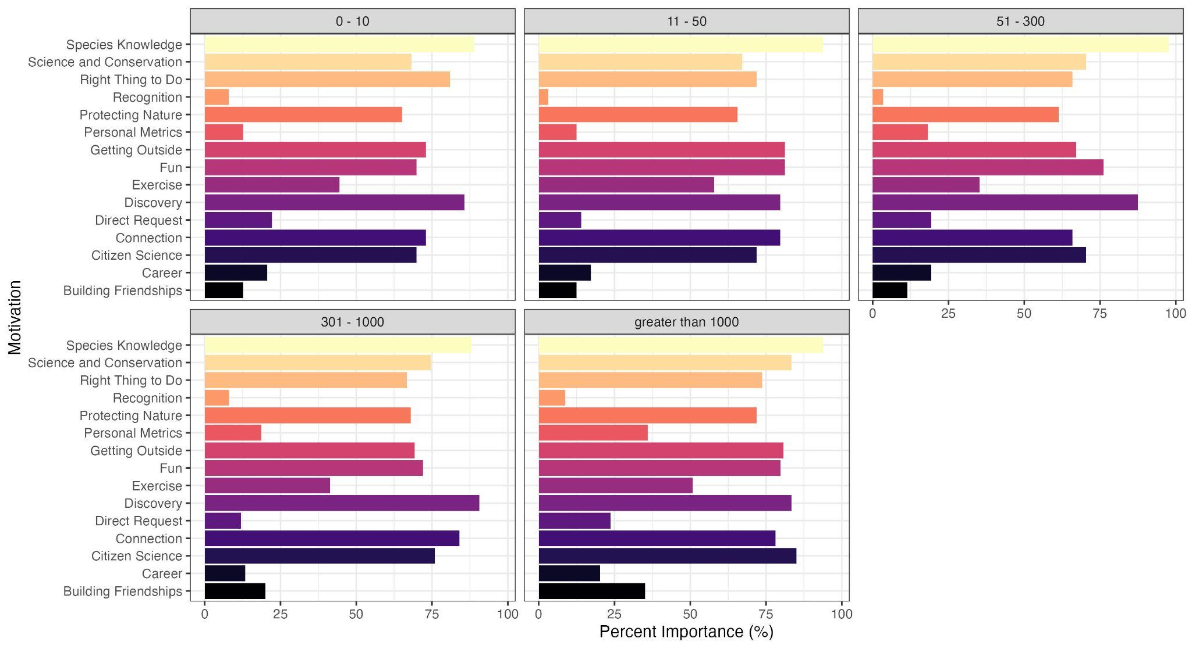

% importance = % of responses rating motivation as “Very” or “Extremely” important
n = 404
Notes:
Talk about how this is showing both teal colors from previous slides (very and extremely important = importance)

Slide 10
Remains highly important
Notes:
Talk about how this is showing both teal colors from previous slides (very and extremely important = importance)

Slide 11
Increases in importance significantly
Notes:
Talk about how this is showing both teal colors from previous slides (very and extremely important = importance)

Slide 12
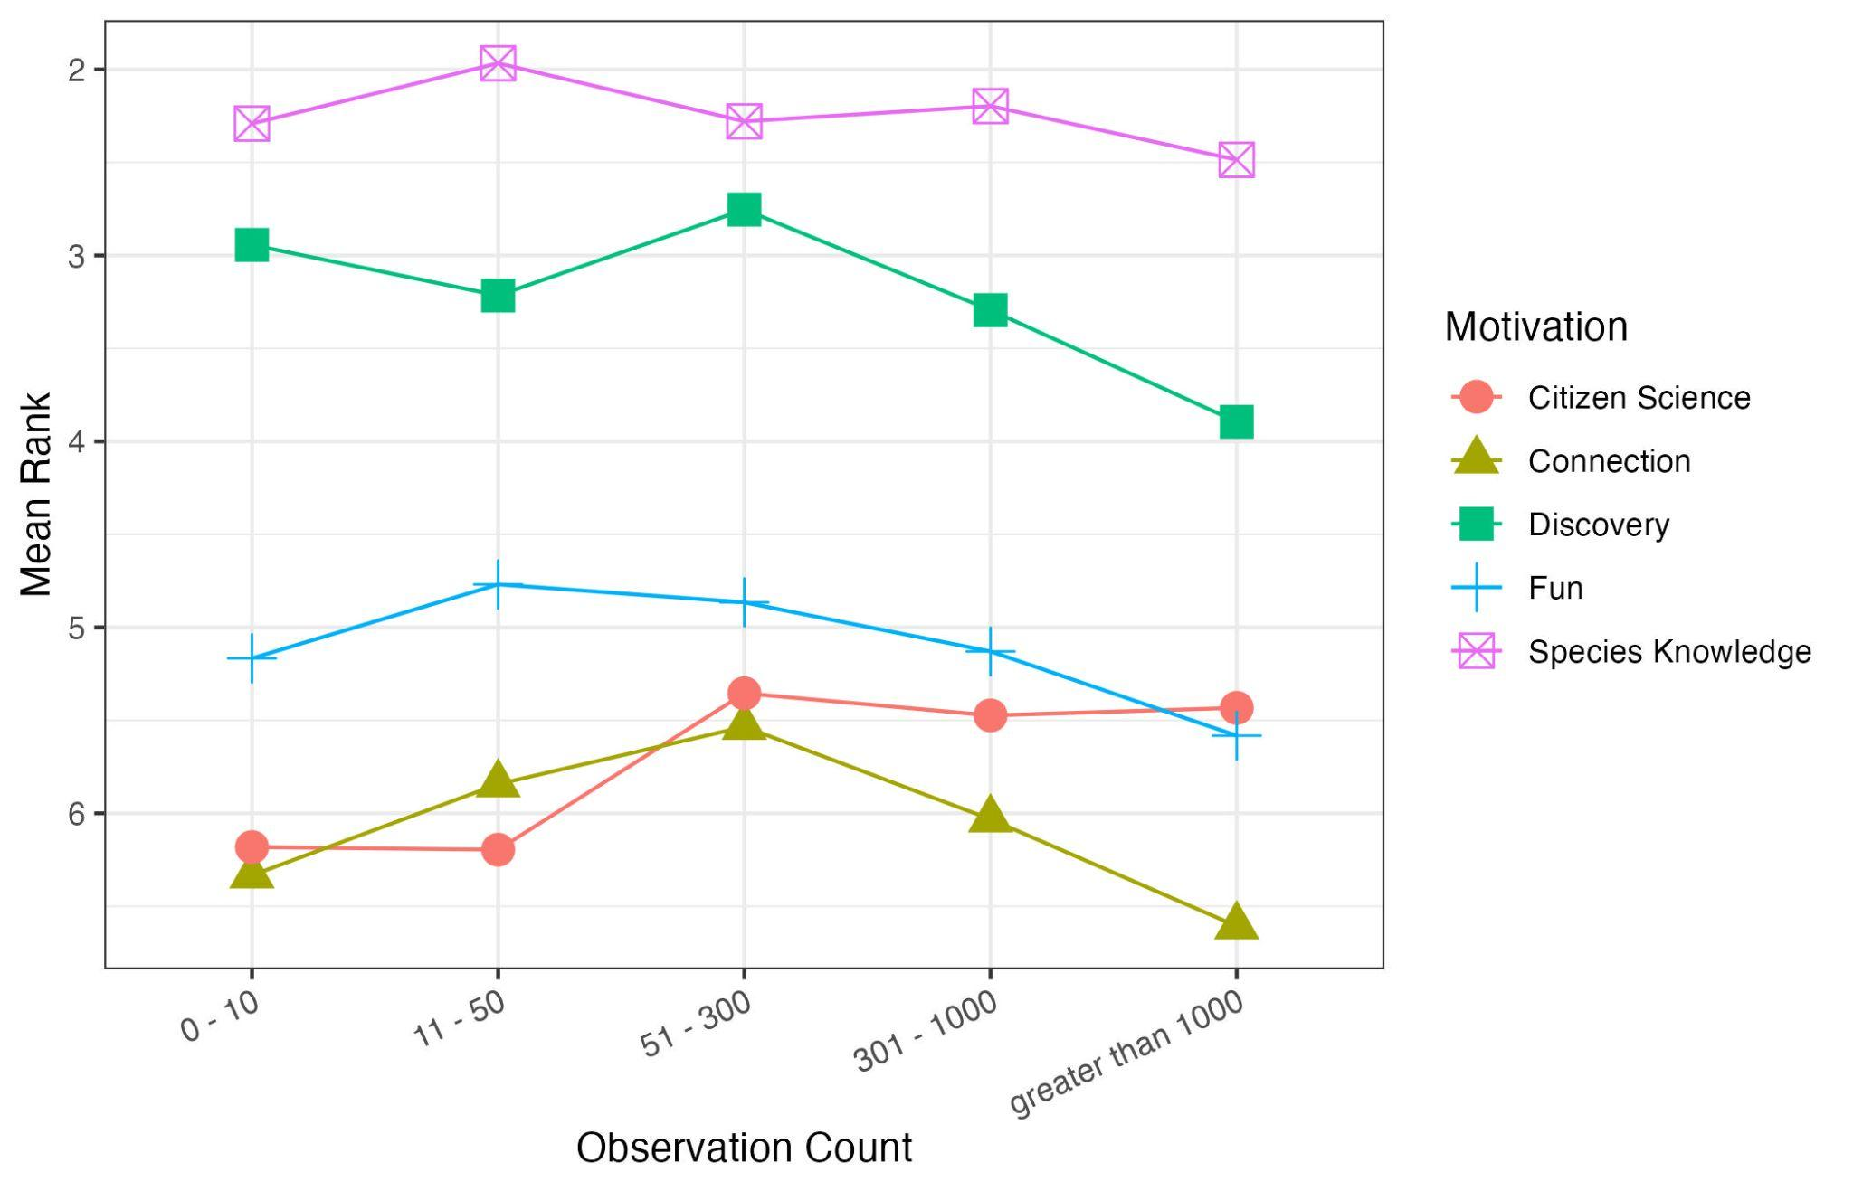

Slide 13
Key takeaways
iNaturalist users are highly motivated by improving their species knowledge and discovering information about ecosystems around them (learning!)
Some motivations vary in importance with participant experience including science and conservation which increases importance
Implications for attracting and retaining users?

Slide 14
Thank you!
Questions?
Contact: lowe.samantha@ufl.edu

Slide 15
Other CAPS prep:
Post moderating form: https://forms.gle/je6qiLfWANfD6GEr5
Moderator instructions: https://docs.google.com/document/d/1ds_VahJFgjmm0rso94FZ9tmAzobi8vY5swxuDigmdnM/edit?usp=sharing
Mentimeter: https://www.mentimeter.com/app/presentation/alor3qqfu1nkj41o4wgfyn82uei6f76o/edit?question=b18faxf7moq9
Master slide deck: https://docs.google.com/presentation/d/1dXQVB8411GkQFnaWg-5ySVIKu24MSE4vmXGE4Mk_Fic/edit?usp=sharing

